Slide 1
NASASP 2021 Virtual Meeting

Slide 2
Welcome!
You may participate on phone or through your computer
All attendees are muted
Please submit any questions in the Control Panel
Today’s webinar is being recorded and will be available on the NASASP website

Slide 3
Executive Session
1:00 pm – 2:25 pm
Elizabeth Cooper
Presiding

Slide 4
Roll Call – Tim Bolles
Minutes of the 2021 National Meeting – Tim Bolles
Treasurer's Report – Kelly Ferrel
Legislative Report - John Chwat
John Chwat – NASASP’s Government Relations Consultant
Arrangements, Publicity, Program Committee Report – Hattie King & Camie Miller
Audit Committee Report – Doug Elkins
Membership Committee Report – Kaelene Borkowski
Nominating Committee Report – Butch Campbell (Speaking)
Overseas Committee Report – Steve Ekin
Technology Committee Report – Camie Miller
Property Oversight Committee Report – Mike Case
Veteran’s Act Committee – Steve Ekin

Slide 5
Government Relations
John Chwat

Slide 13
Arrangements, Publicity, Program Committee Report – Hattie King & Camie Miller
Audit Committee Report – Doug Elkins
Membership Committee Report – Kaelene Borkowski
Nominating Committee Report – Butch Campbell (Speaking)
Overseas Committee Report – Steve Ekin
Technology Committee Report – Camie Miller
Property Oversight Committee Report – Mike Case
Veteran’s Act Committee – Steve Ekin

Slide 14
Time Permitting
Break

Slide 15
General Session
&
Federal Partners
2:30 pm – 4:15 pm
Elizabeth Cooper
Presiding

Slide 16
02:30 – 03:15 SBA, Veterans Small Business – Christopher Clarke
03:15 – 03:30 GSA Personal Property Management –
Matt Manger (Speaking), Lori Marrs, Joe Hvorecky,
Sandra Klar
03:30 – 03:45 Defense Logistics Agency – Cassie Gilbert
03:45 – 04:00 Question & Answer session
04:00 – 04:15 Future Meetings Discussion
2022 – Washington, DC for NASASP’s 75th anniversary
2023 – Boise, Idaho
2024 – Grand Rapids, Michigan

Slide 17
SBA Veteran’s Small Business Enhancement Act
Christopher Clarke

Slide 18
GSA
Office of Personal Property Update
Matthew Manger

Slide 28
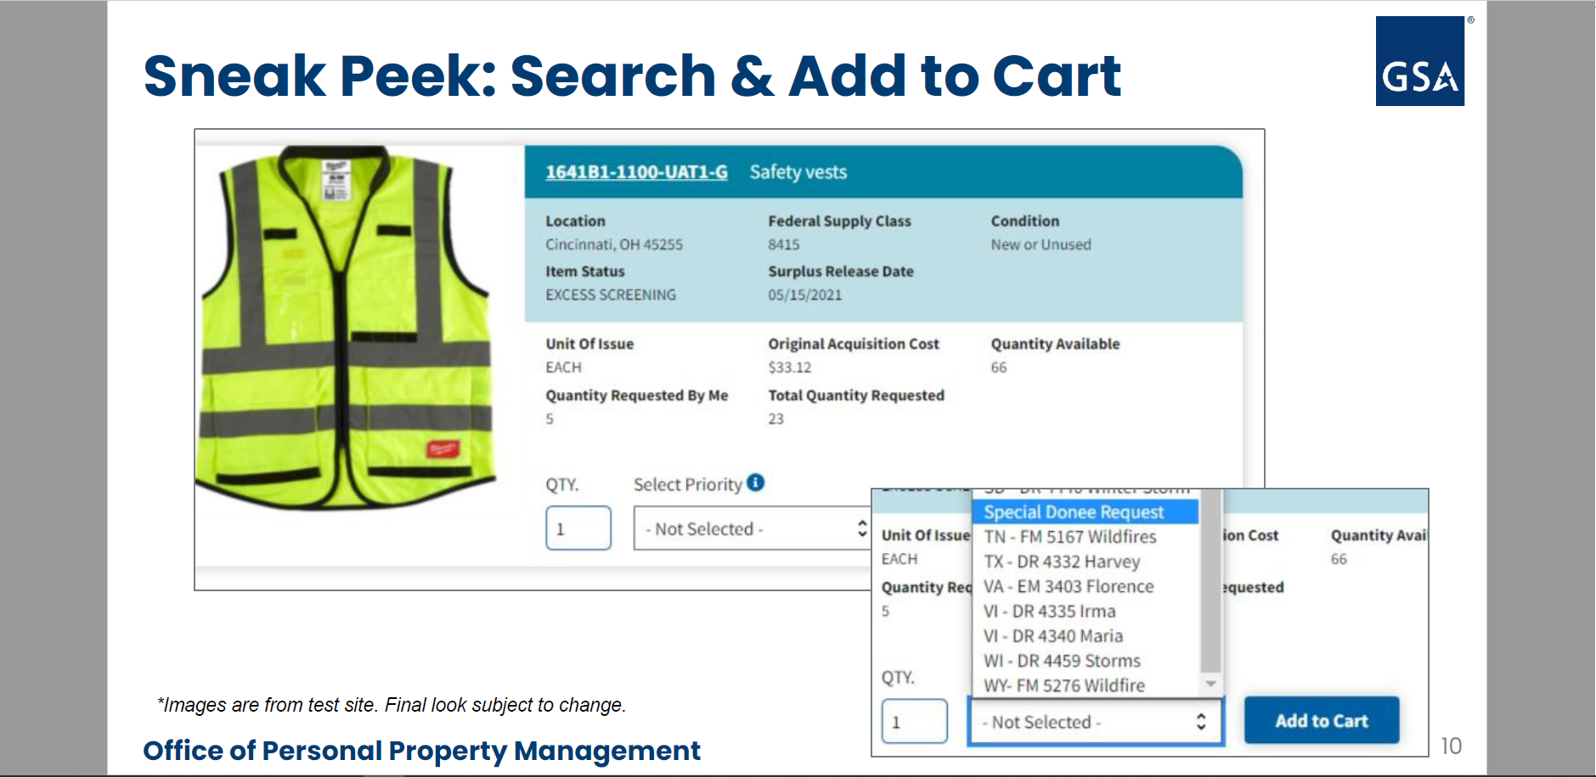

Slide 29
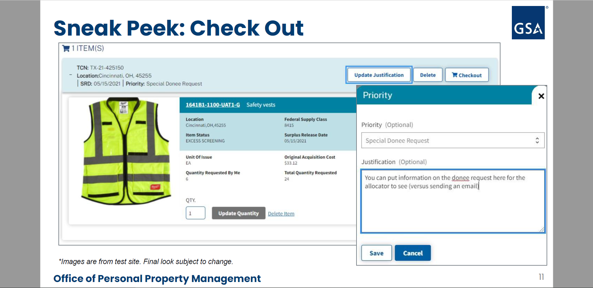

Slide 35
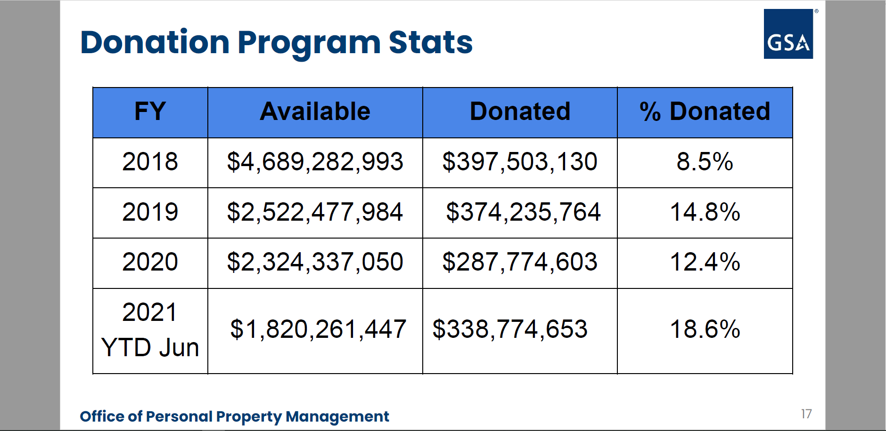

Slide 37
Defense Logistics Agency
Cassandra Gilbert

Slide 43
General
Questions & Answers

Slide 44
Future Meetings

